Slide 1


Slide 2

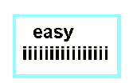

Notes:
Answer: Easy on the eyes

Slide 3

LOGARITHMS

Slide 4
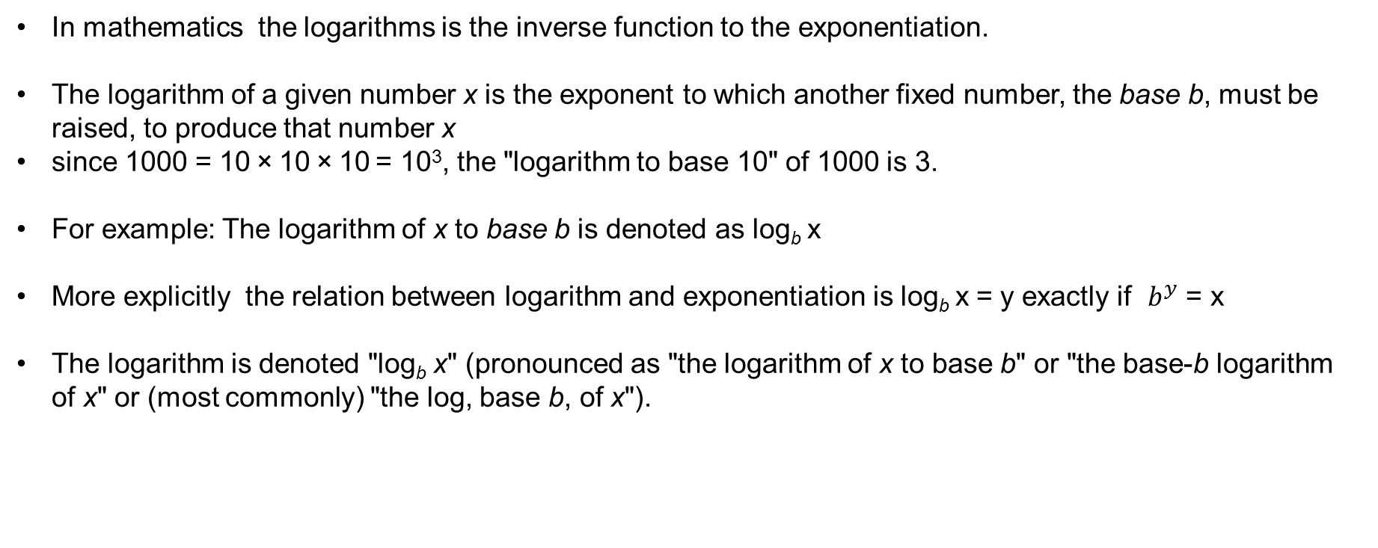
INTRODUCTION
In mathematics the logarithms is the inverse function to the exponentiation.
The logarithm of a given number x is the exponent to which another fixed number, the base b, must be raised, to produce that number x
since 1000 = 10 × 10 × 10 = 10³, the "logarithm to base 10" of 1000 is 3.
For example: The logarithm of x to base b is denoted as log_{b} x
More explicitly the relation between logarithm and exponentiation is log_{b} x = y exactly if $b^{y}$ = x
The logarithm is denoted "log_{b} x" (pronounced as "the logarithm of x to base b" or "the base-b logarithm of x" or (most commonly) "the log, base b, of x").

Slide 5
CONCEPTS
Logarithm, the exponent or power to which a base must be raised to yield a given
number.
Expressed mathematically, x is the logarithm of n to the base b if b^{x} = n, in which
case one writes x = log_{b} n.
For example, 2³ = 8; therefore, 3 is the logarithm of 8 to base 2, or 3 = log₂ 8.

Slide 6
EXAMPLE PROBLEM
Meaning of logarithm :
How many 3s do we multiply to get 81?
3*3*3*3=81
So We write “the number of 3s we need to multiply to get 81 is 4”. So
log₂(8) =4 , Now we are relating this into log
3^4=81
Notes:
Explanation:
In the school,
Boys = 4/7 × 1554 = 888
Girls = 3/7 × 1554 = 666
After 30 days, Girls = 666 + 30 = 696 If x boys leave the school, then, According to the question,
(888– x)/ 696 = 7/6
(888– x)/ 116 = 7
888 – x = 116 × 7 = 812
x = 888 – 812 = 76

Slide 7
So, we can say
loga X= N
a^N = X and viceversa a^n=x
loga x= n

Slide 8
RULES OF LOGARITHM
Rule name Rule
Logarithm product rule log_{b}(x ∙ y) = log_{b}(x) + log_{b}(y)
Logarithm quotient rule log_{b}(x / y) = log_{b}(x) - log_{b}(y)
Logarithm power rule log_{b}(x ^{y}) = y ∙ log_{b}(x)
Logarithm base switch rule log_{b}(c) = 1 / log_{c}(b)
Logarithm base change rule log_{b}(x) = log_{c}(x) / log_{c}(b)
Derivative of logarithm f (x) = log_{b}(x) ⇒ f ' (x) = 1 / ( x ln(b) )
Integral of logarithm ∫ log_{b}(x) dx = x ∙ ( log_{b}(x) - 1 / ln(b) ) + C

Slide 9
CONCEPT
Logarithm of negative number log_{b}(x) is undefined when x≤ 0
Logarithm of 0 log_{b}(0) is undefined
Logarithm of 1 log_{b}(1) = 0
Logarithm of the base log_{b}(b) = 1
Logarithm of infinity lim log_{b}(x) = ∞,when x→∞
Notes:
Explanation:
Tickets of type A = 3x
Tickets of type B = 2x
Tickets of type C = 5x
According to the question,
(3x × 1000 + 2x × 500 + 5x × 200)
= 2.5 × 10000000
30x + 10x + 10x = 250000
50x = 250000
x = 5000

Slide 10
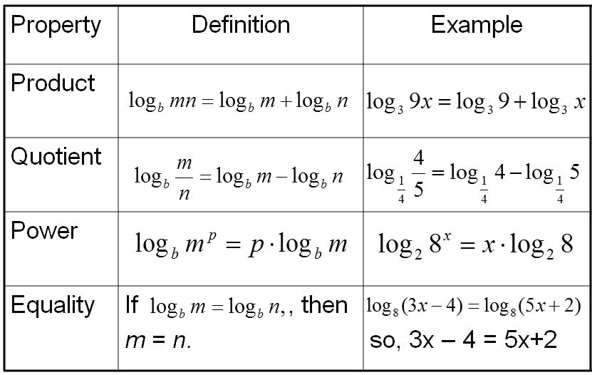
IMPORTANT TERMS

Slide 11
Question: 01
Evaluate the expression below using Log Rules
log₂(8) + log₂(4)
2
3
4
5
Answer: D

Slide 12
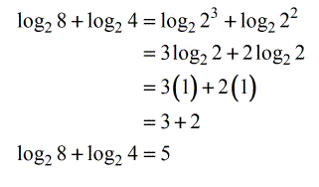
Question: 01
Solution:
Express 8 and 4 as exponential numbers with base 2. Then, apply Power Rule followed by Identity Rule. After doing so, you add the resulting values to get your final answer.

Slide 13
Question: 02
Evaluate the expression below using Log Rules.
log₃(162) – log₃(2)
2
5
4
1
Answer: C

Slide 14
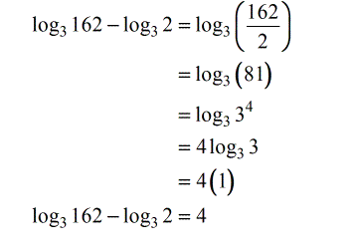
Question: 02
Solution:

Slide 15
Question: 03
Evaluate the expression below.
log₅(500)- 2log₅(2) + log₄(32 )+ log₄(8)
4
5
6
7
Answer: D

Slide 16
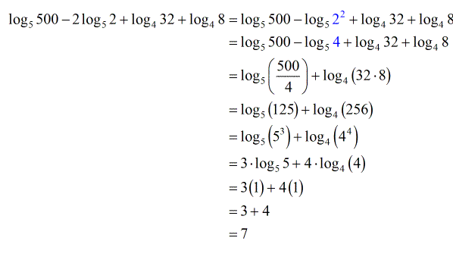
Question: 03
Solution:

Slide 17
Question: 01
If log 27 = 1.431, then the value of log 9 is ___________.
A. 0.934
B. 0.945
C. 0.954
D. 0.958
Answer: C

Slide 18
Explanation: 01
Log 27=1.431
log (3³ ) = 1.431
3 log 3 = 1.431
log 3 = 0.477
log 9 = log(3² ) = 2 log 3 = (2 x 0.477) = 0.954.

Slide 19
Question: 02
log₆(216) + [ log(42) - log(6) ] / log(49)
A. 7/2
B. 1/2
C. 4/3
D. 2/3
Answer: A

Slide 20
Explanation: 02
log₆(216) + [ log(42) - log(6) ] / log(49)
= log₆(6³) + log(42/6) / log(7²)
= 3 + log(7) /2 log(7) = 3 + ½
= 7/2

Slide 21
Question: 03
Find the value of log₂ 2 + log₂ 2² + log₂ 2³ + ........ + log₂ 2^{n}.
A. n(n+1)/2
B. n+1
C. n
D. 2n
Answer: A

Slide 22
Explanation: 03
log₂ 2 + log₂ 2² + log₂ 2³ + ........ + log₂ 2^{n} = log₂ 2 + 2log₂ 2 + 3log₂ 2 + ........ + nlog₂ 2 = 1+2+3+........+n = n(n+1)/2

Slide 23
Question: 04
If log 2 = 0.301 and log 3 = 0.4771, find the number of digits in 48¹²?
A. 19
B. 20
C. 21
D. 24
Answer: C

Slide 24
Explanation: 04
We have log 48¹² = 12 × log 48 = 12 × log (2⁴ × 3) = 12 × (4 log 2 + log 3) = 12 × (4 × 0.301 + 0.4771) = 12 × (1.204 + 0.4771) = 12 × 1.6811 = 20.1732 Now the characteristic is 20, so the number of digits = 20 + 1 = 21.

Slide 25
Question: 05
Solve for ‘x:’ the equation is 2log₂x – log₂ (x – 2) = 3
A. 6
B. 4
C. 1
D. 2
Answer: B

Slide 26
Explanation: 05
We have 2log₂x – log₂ (x – 2) = 3 ⇒ log₂x² – log₂ (x – 2) = 3 ⇒ log₂(x²/x-2) = 3 ⇒ log₂(x²/x-2) = 2³ = 8 ⇒ x² = 8(x-2) ⇒ x² - 8x + 16 = 0 ⇒ (x-4)² = 0 ⇒ x=4 Hence answer is option B

Slide 27
Question: 06
If log₁₀ 2 = 0.3010, the value of log₁₀ 80 is _________.
A. 1.6020
B. 1.9030
C. 9030
D. None of these
Answer: B

Slide 28
Explanation: 06
log₁₀ 80 = log₁₀ (8 *10)
= log₁₀ 8 + log₁₀ 10
= log₁₀ (2³ ) + 1
= 3 log₁₀ 2 + 1
= (3 x 0.3010) + 1
= 1.9030.

Slide 29
Question: 07
If log₁₀ 5 + log₁₀ (5x + 1) = log₁₀ (x + 5) + 1, then x is equal to:
A. 1
B. 3
C. 5
D. 10
Answer: B

Slide 30
Explanation: 07
log₁₀ 5 + log₁₀ (5x + 1) = log₁₀ (x + 5) + 1
log₁₀ 5 + log₁₀ (5x + 1) = log₁₀ (x + 5) + log₁₀ 10
log₁₀ [5 (5x + 1)] = log₁₀ [10(x + 5)]
5(5x + 1) = 10(x + 5)
5x + 1 = 2x + 10
3x = 9
x = 3.

Slide 31
Question: 08
log₃x + log_{x}3 =17/4. Find X?
A. 3⁴
B. 3^{1/8}
C. 3^{1/4}
D. 3^{1/3}
^{Answer: C}

Slide 32
Explanation: 08
log₃x + log_{x}3 =17/4
Let y = log₃x
We know that log_{x}3 =1/log 3(x)
Thus the equation can be written as y + 1/y = 174
4y² + 4 = 17y 4y² + 4 - 17y = 0
y = 4 or ¼
log₃x = 4
Then x = 3⁴
If y = 1/4
log₃x = 1/4
x = 3^{1/4}

Slide 33
Question: 11
If log x + log (x + 3) = 1 then the value(s) of x will be, the solution of the equation
x + x + 3 = 1
x + x + 3 = 10
x (x + 3) = 10
x (x + 3) = 1
^{Answer : C}

Slide 34
Explanation: 11
taking log x= log10x
using the law of logs
Log A+log B=log AB
we have
Log x+log (x+3)=1
Log x(x+3)=1−−(1)
definition of logs
Log ab=c⇒ac=b
(1)→101=x(x+3)
∴x2+3x=10
x2+3x−10=0
factorising and solving
(x+5)(x−2)=0
⇒x=−5, or x=2
When solving with x=2 the equation becomes as option c

Slide 35
Question: 12
Find x if log x = log 1.5 + log 12
A. 18
B. 8
C. 15
D. 12
Answer: A

Slide 36
Explanation: 12

Slide 37
Question: 13
log_{a}4 + log_{a}16 + log_{a}64 + log_{a}256 = 10. Then a = __________.
2
4
8
5
Answer: B

Slide 38
log a ⁽⁴⁺¹⁶⁺⁶⁴⁺²⁵⁶⁾ =10 log a 4¹⁰ =10 then a=4
Explanation: 13
log a ⁽⁴⁺¹⁶⁺⁶⁴⁺²⁵⁶⁾ =10 log a 4¹⁰ =10 then a=4

Slide 39
Question: 14
Log₁₅ 3375 × log ₄ 1024 = __________.
1
18
4
15
Answer: D

Slide 40
Explanation: 14
log₁₅3375 × log₄1024 = 3 log15 15 × 5 log4 4 = 3 × 5 = 15

Slide 41
Question: 15
If log 3 = 0.4771, find log (0.81) ² × log (27/10)^{2/3} π log 9.
2.689
-0.0552
2.2402
2.702
Answer: D

Slide 42
Explanation: 15

Slide 43
THANK YOU

